Slide 1

PC: https://xkcd.com/1838

Slide 2
Debugging Data & Models
Eric Wong
8/30/2022

Slide 3
Course website
https://www.cis.upenn.edu/~exwong/debugml/

Slide 4
Location
Tuesday - Rittenhouse Laboratory 4C6
Thursday - Chemistry Library 514
1:45 – 3:15 PM

Slide 5
What is in this course?

Slide 6
Research topics in debugging ML
Failure modes
Debugging tools
ML repair

Slide 7



Failure modes
Biases, distribution shifts, adversarial changes

Slide 8
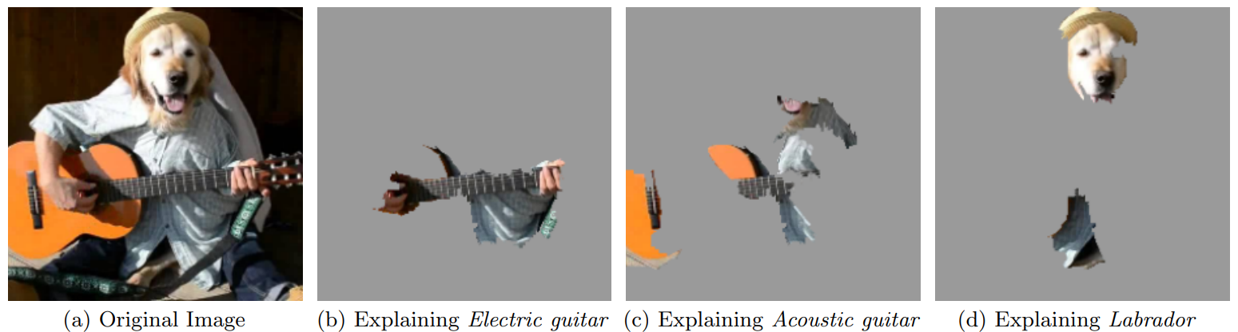
Debugging tools
Explainability, verification, scientific discovery
Ribeiro et al 2016. "Why should i trust you?" Explaining the predictions of any classifier.

Slide 9
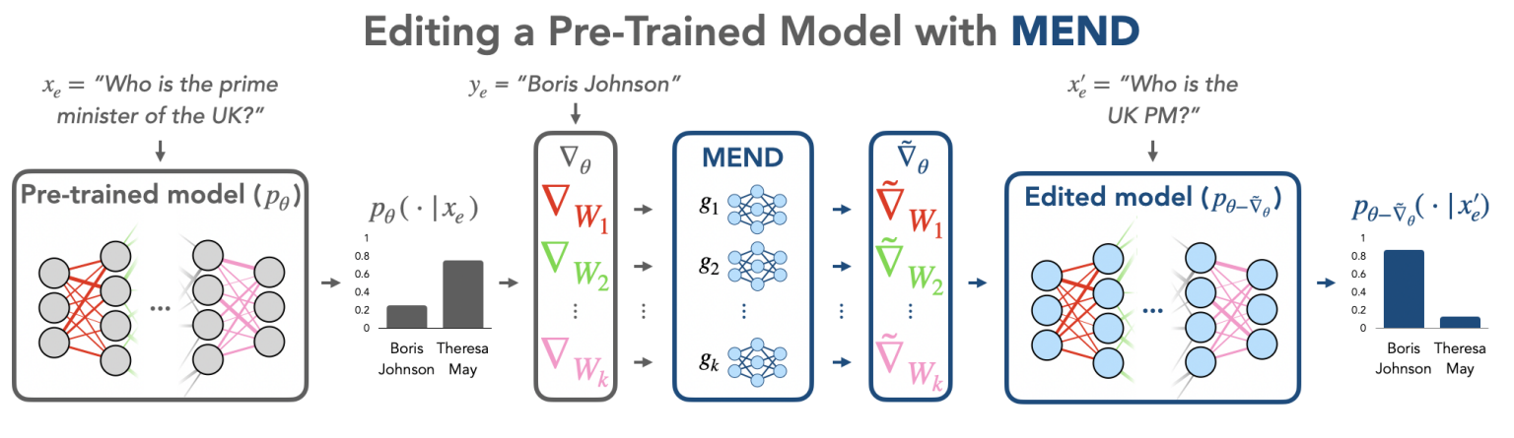
ML repair
Robust training, data interventions, model adjustments
PC: Mitchell et al 2022. Fast Model Editing at Scale.

Slide 10
We will cover:
Known problems with data/models
Assumptions and limitations of solutions
Mathematics, statistics, optimization
Primarily vision & language

Slide 11
Prerequisites
ML intro course (i.e. CIS 519/520)
Linear algebra (i.e. Gilbert Strang’s 18.06)
Statistics (i.e. STAT 512)
Bonus: optimization/deep learning (?)

Slide 12
We will not cover:
How to fix your model
Practical, general purpose debugging tools
But: could be a course project!

Slide 13
Goals (PhD centric)
Primer on research topics in debugging ML
Research experience
Communication

Slide 14
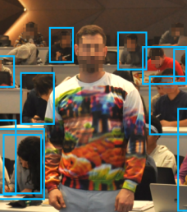

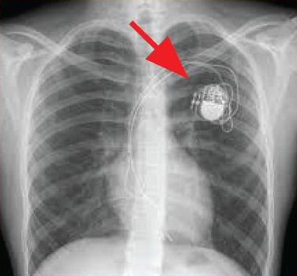
1. Debugging ML
Overview of open problems & critical discussion of papers

Slide 15
Lectures
Not taking attendance
No recorded lectures
Masks required (may revisit later)
Laptops in the back

Slide 16
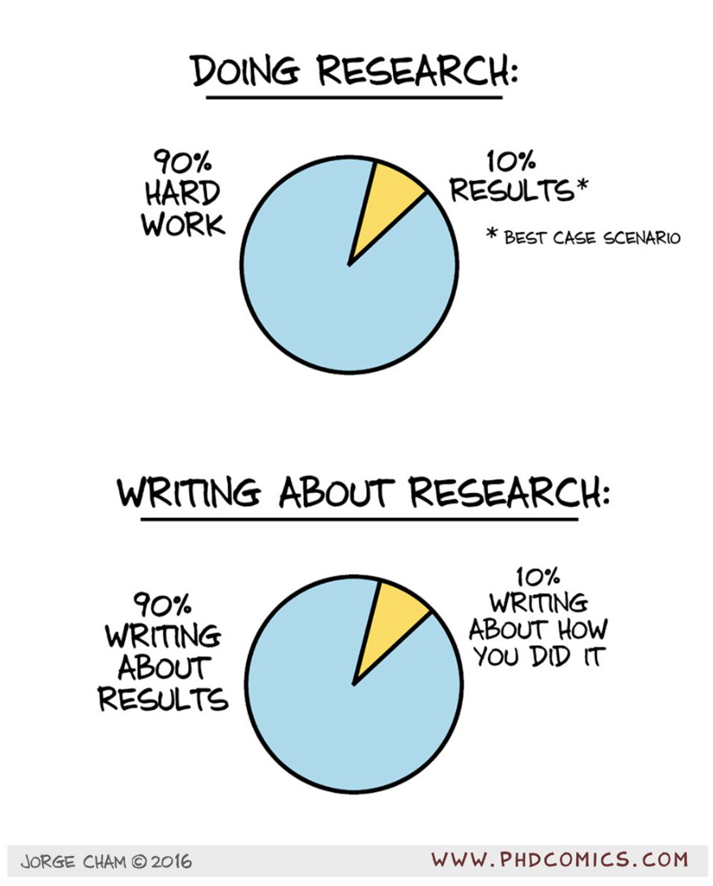
2. Research experience
Gain experience by doing

Slide 17
Project
Tackle a research problem in trustworthy ML
Examples:
Debug a problem in an ML application (medical, genetic, etc.)
Analyze or create debugging tools
Audit a ML pipeline

Slide 18
Project checkpoints
Proposal (Oct 4th)
Mid-report (Nov 1st)
Final report (Dec 15th)
Groups of 1-3

Slide 19
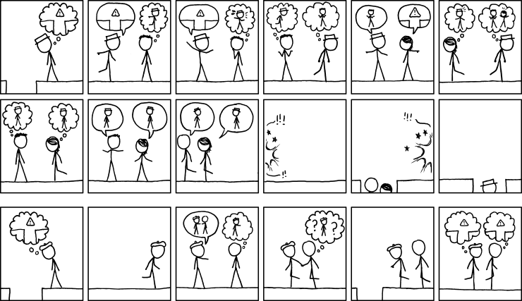
3. Communication
Practice explaining and conveying ideas

Slide 20
Presentations
2 paper talks
Project checkpoint talk
Final project talk
Peer evaluation

Slide 21
Readings
Weekly readings (you can suggest)
Post a thought, question, or observation in Ed Discussion before class (skim)
Sign up to present two papers over semester (in-depth)

Slide 22
Project presentations
Checkpoint presentation (late October-early November)
Final presentation (Dec 6/8)
Sign up for a time slot

Slide 23
Class structure
Approximately:
30-60m of “lecture”
30-60m of reading discussion
15m of project updates

Slide 24
Mask policy
To ensure that health reasons do not deter anyone from coming to class, masks are required.
Masks are not provided by the university on a weekly basis. Come by my office if this is an issue.
If you are sick, consider staying home.

Slide 25
No recordings, but…
Lecture notes
Slides
Jupyter notebooks
Office hours

Slide 26
Disclaimer
New course
Feedback form on website
Adjustments can be made

Slide 27
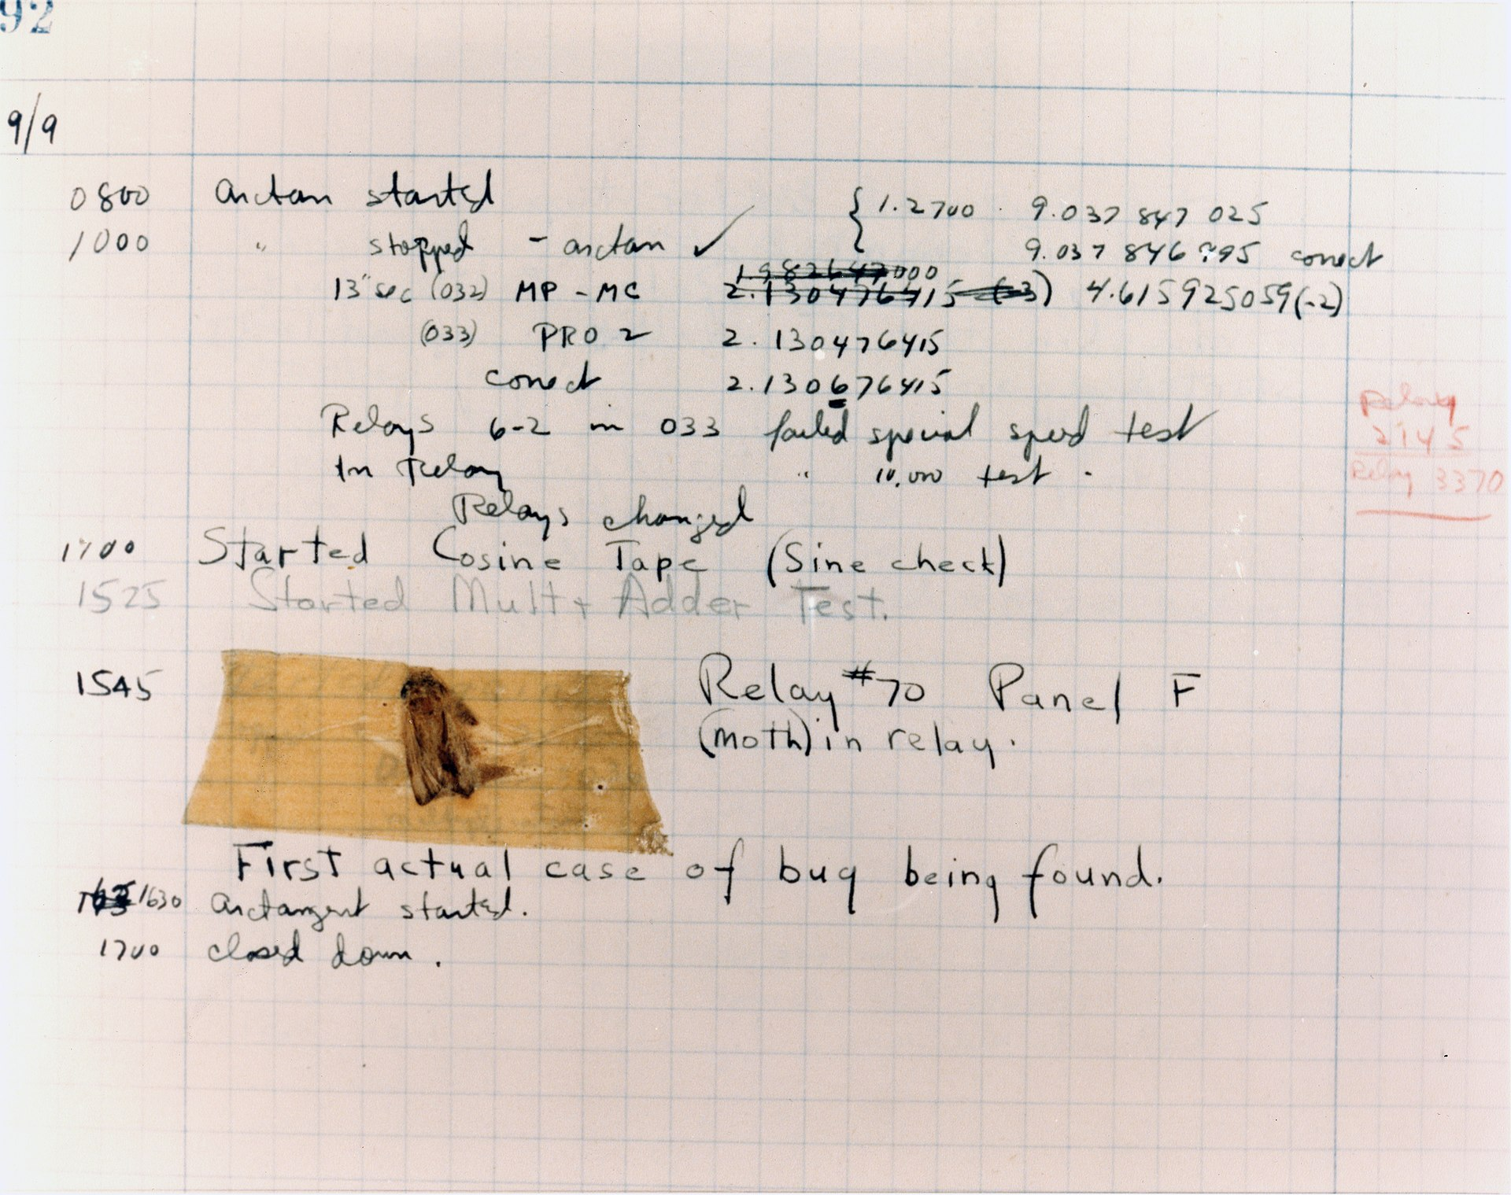
What is debugging?

